Slide 1
A variant of D² statistic for repetitive region detection
Sijie Chen
Tsinghua University

Slide 2
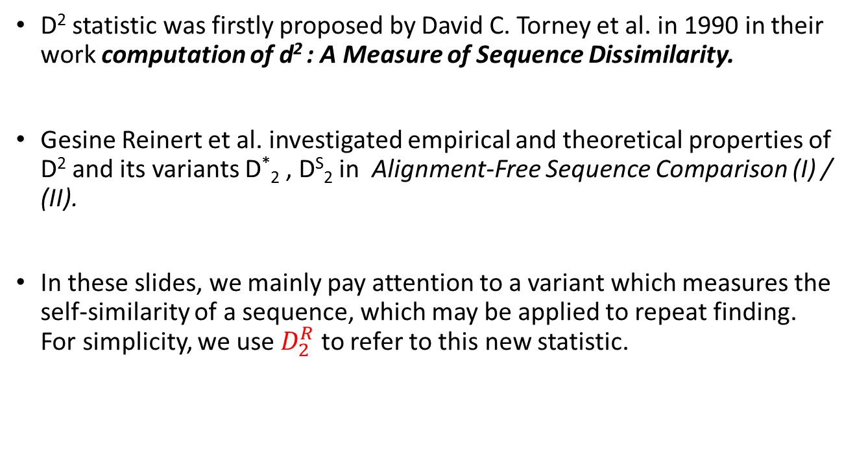
D² statistic family
D² statistic was firstly proposed by David C. Torney et al. in 1990 in their work computation of d² : A Measure of Sequence Dissimilarity.
Gesine Reinert et al. investigated empirical and theoretical properties of D² and its variants D*₂ , D^{S}₂ in Alignment-Free Sequence Comparison (I) / (II).
In these slides, we mainly pay attention to a variant which measures the self-similarity of a sequence, which may be applied to repeat finding. For simplicity, we use $D_{2}^{R}$ to refer to this new statistic.

Slide 3


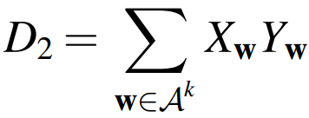
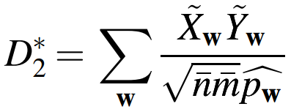
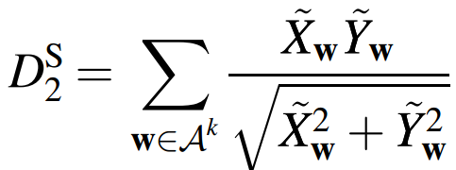
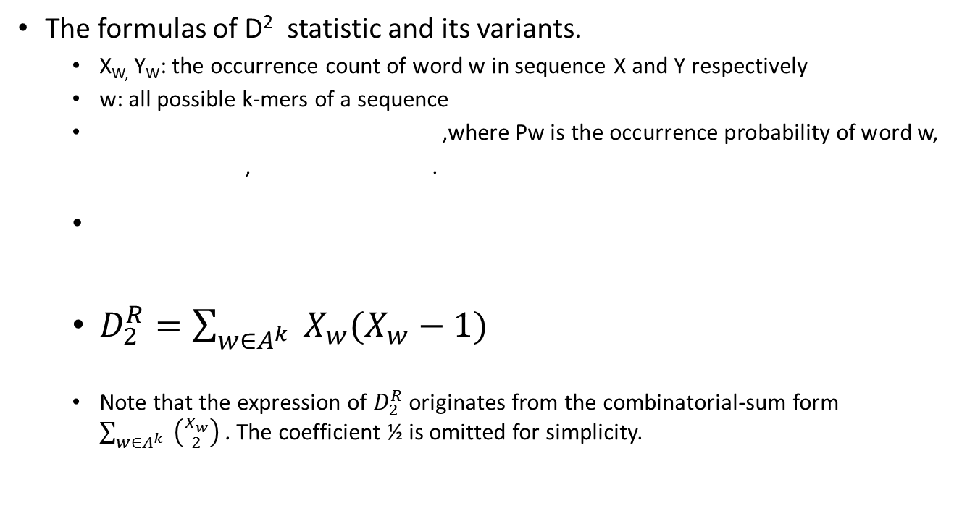
D² statistic family
The formulas of D² statistic and its variants.
X_{W,} Y_{W}: the occurrence count of word w in sequence X and Y respectively
w: all possible k-mers of a sequence
,where Pw is the occurrence probability of word w,
, .
$D_{2}^{R}=\sum_{w∈A^{k}}{ X_{w}(X_{w}−1)}$
Note that the expression of $D_{2}^{R}$ originates from the combinatorial-sum form $\sum_{w∈A^{k}}{ \left({X_{w} \atop 2}\right)}$ . The coefficient ½ is omitted for simplicity.

Slide 4
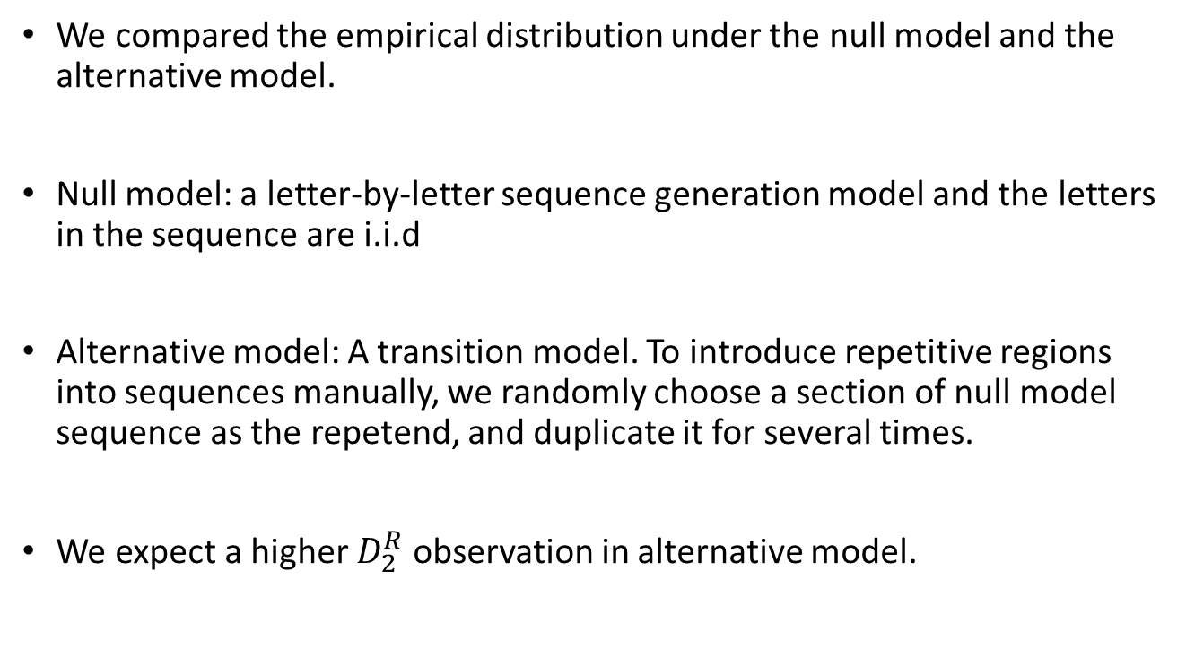
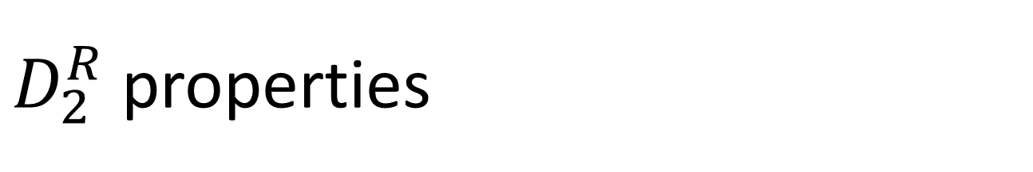
$D_{2}^{R}$ properties
We compared the empirical distribution under the null model and the alternative model.
Null model: a letter-by-letter sequence generation model and the letters in the sequence are i.i.d
Alternative model: A transition model. To introduce repetitive regions into sequences manually, we randomly choose a section of null model sequence as the repetend, and duplicate it for several times.
We expect a higher $D_{2}^{R}$ observation in alternative model.

Slide 5
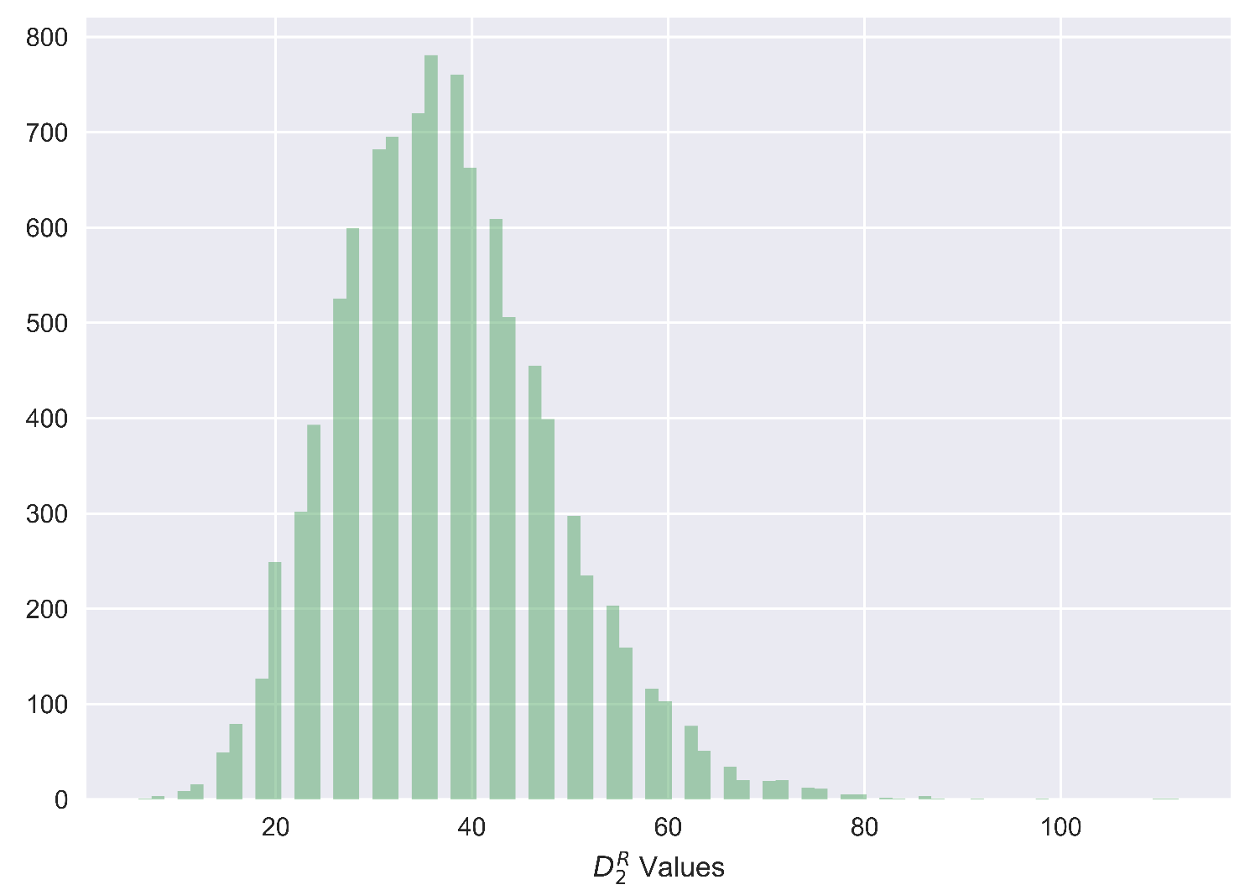
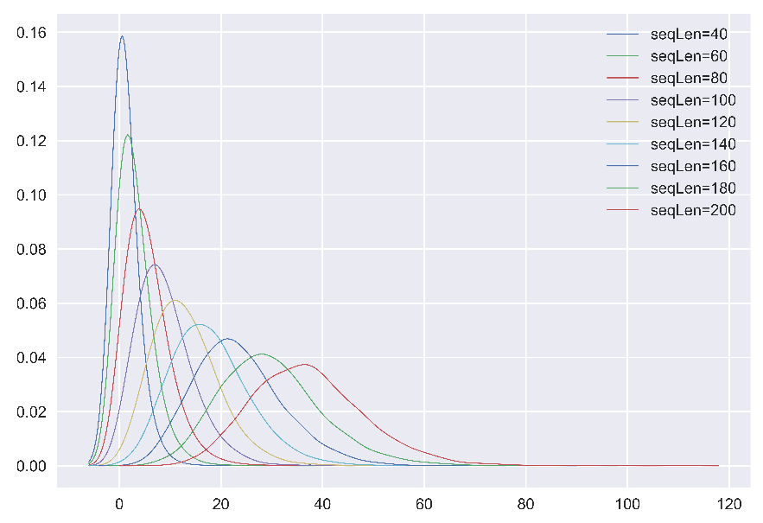
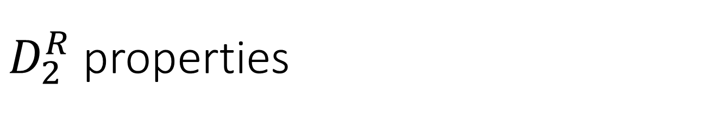
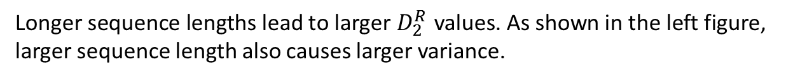
$D_{2}^{R}$ properties
Sequence Length’s Impact
The left figure gives the empirical distribution when sequence length =200.
The total # of sequences generated is 10000. To avoid visual inconvenience caused by overlapping , we used kernel density estimation curve instead of histogram to compare multiple conditions in following figures.
Longer sequence lengths lead to larger${ D}_{2}^{R}$ values. As shown in the left figure, larger sequence length also causes larger variance.

Slide 6
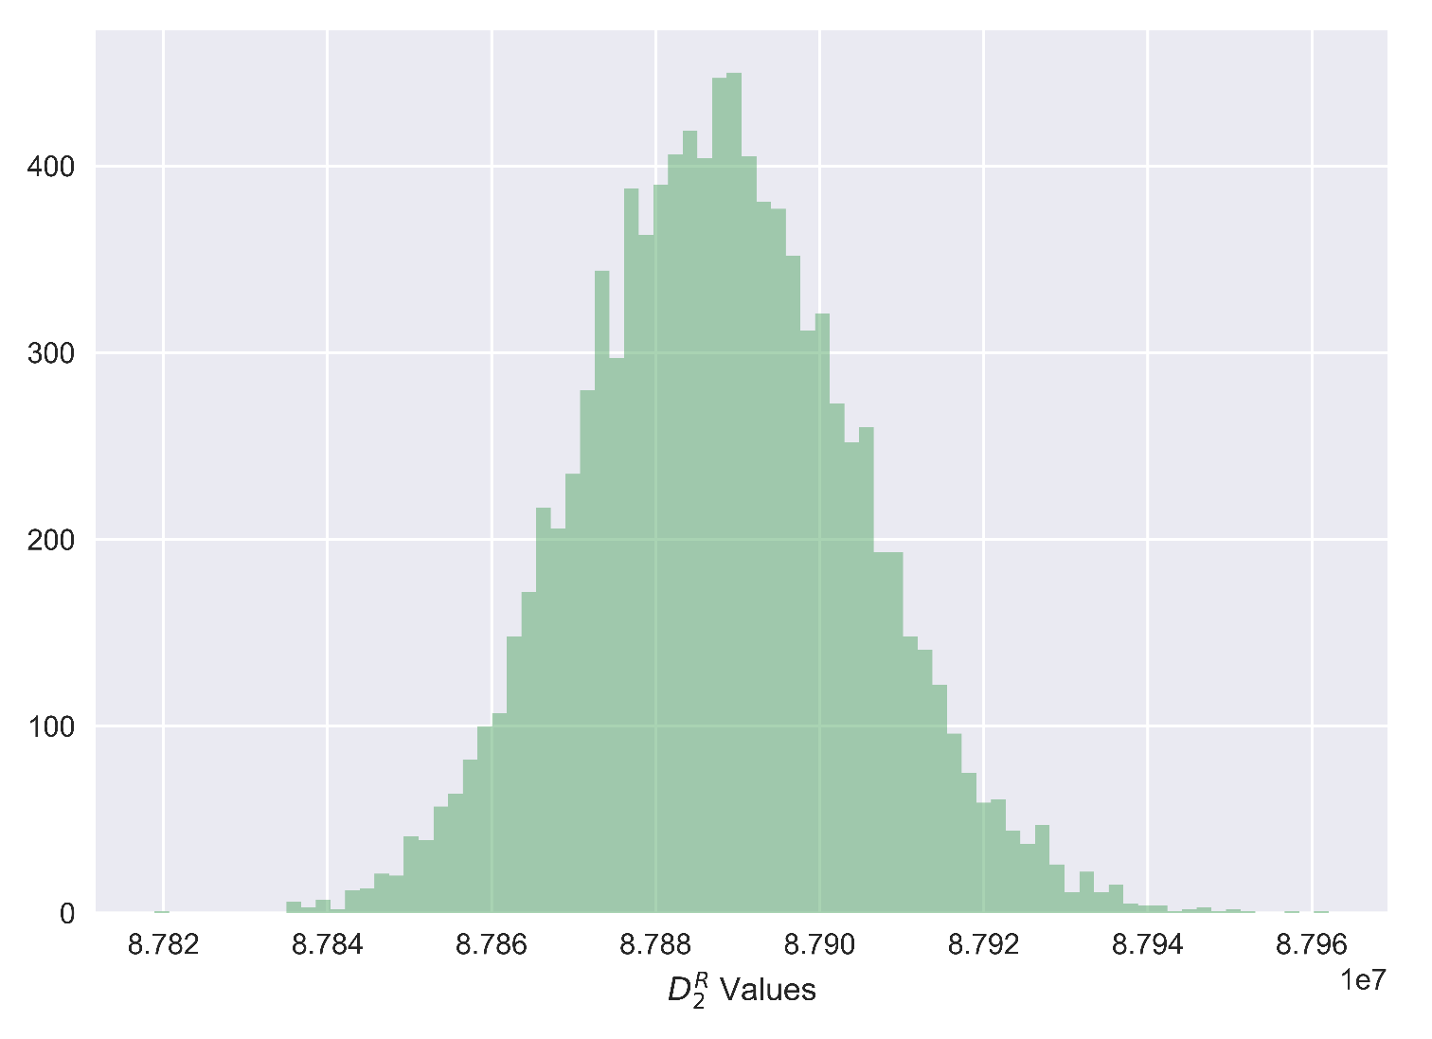
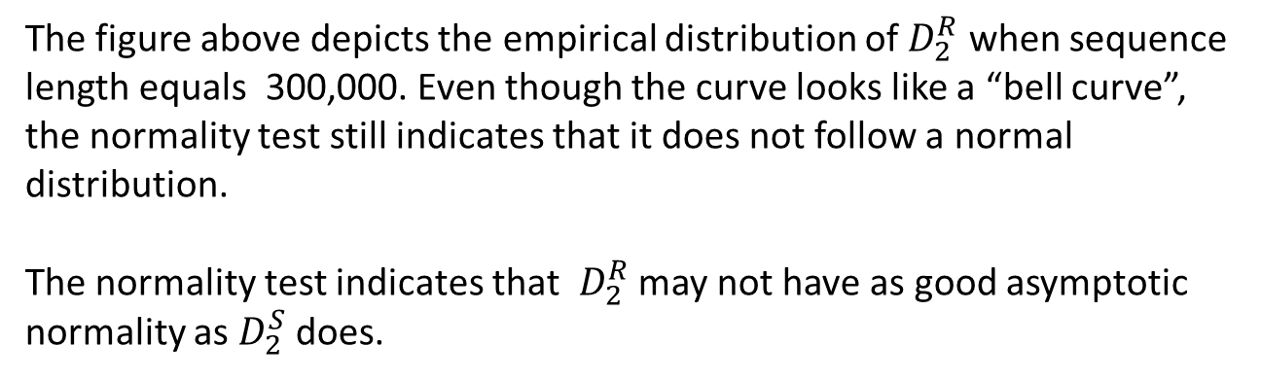
$D_{2}^{R}$ properties
When Sequence Length Tends to ∞
Seq Len | Test p-value
300 | 1.141e-56
3,000 | 3.697e-13
30,000 | 3.443e-12
300,000 | 7.038e-08
The figure above depicts the empirical distribution of $D_{2}^{R}$ when sequence length equals 300,000. Even though the curve looks like a “bell curve”, the normality test still indicates that it does not follow a normal distribution.
The normality test indicates that $D_{2}^{R}$ may not have as good asymptotic normality as $D_{2}^{S}$ does.

Slide 7
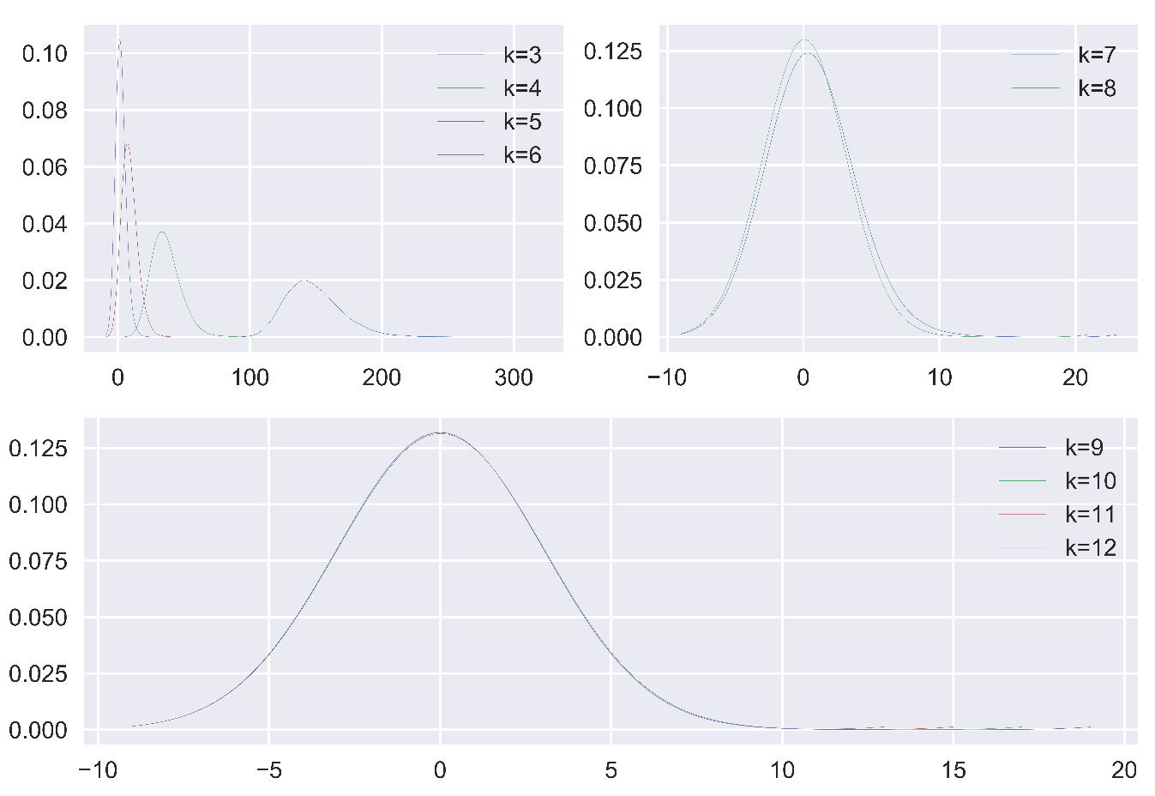
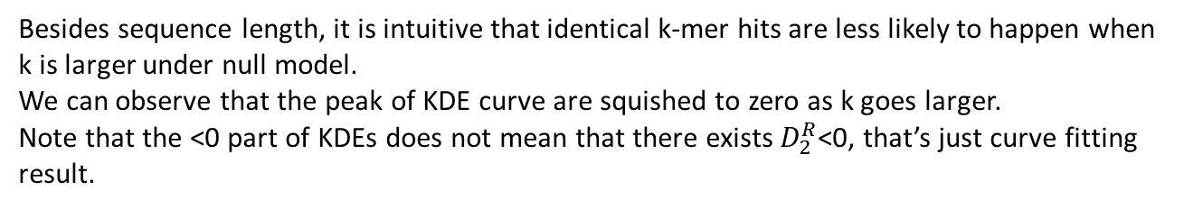
$D_{2}^{R}$ properties
K-mer Length’s Impact
Besides sequence length, it is intuitive that identical k-mer hits are less likely to happen when k is larger under null model.
We can observe that the peak of KDE curve are squished to zero as k goes larger. Note that the <0 part of KDEs does not mean that there exists $D_{2}^{R}$<0, that’s just curve fitting result.

Slide 8
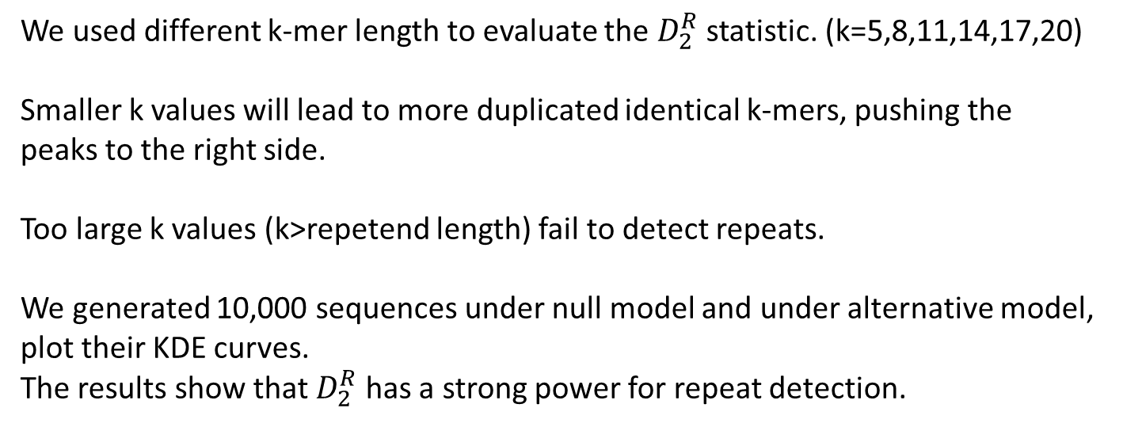
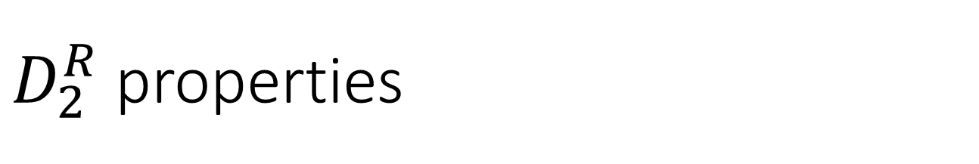
$D_{2}^{R}$ properties
Discriminate Repeats from Non-repeats
In our alternative model, we simulated interspaced repeats with spacer length= 10, repetend length=18, repetend count=5.
repetend
spacer
repetend
spacer
repetend
spacer
repetend
spacer
repetend
We used different k-mer length to evaluate the $D_{2}^{R}$ statistic. (k=5,8,11,14,17,20)
Smaller k values will lead to more duplicated identical k-mers, pushing the
peaks to the right side.
Too large k values (k>repetend length) fail to detect repeats.
We generated 10,000 sequences under null model and under alternative model, plot their KDE curves. The results show that $D_{2}^{R}$ has a strong power for repeat detection.

Slide 9
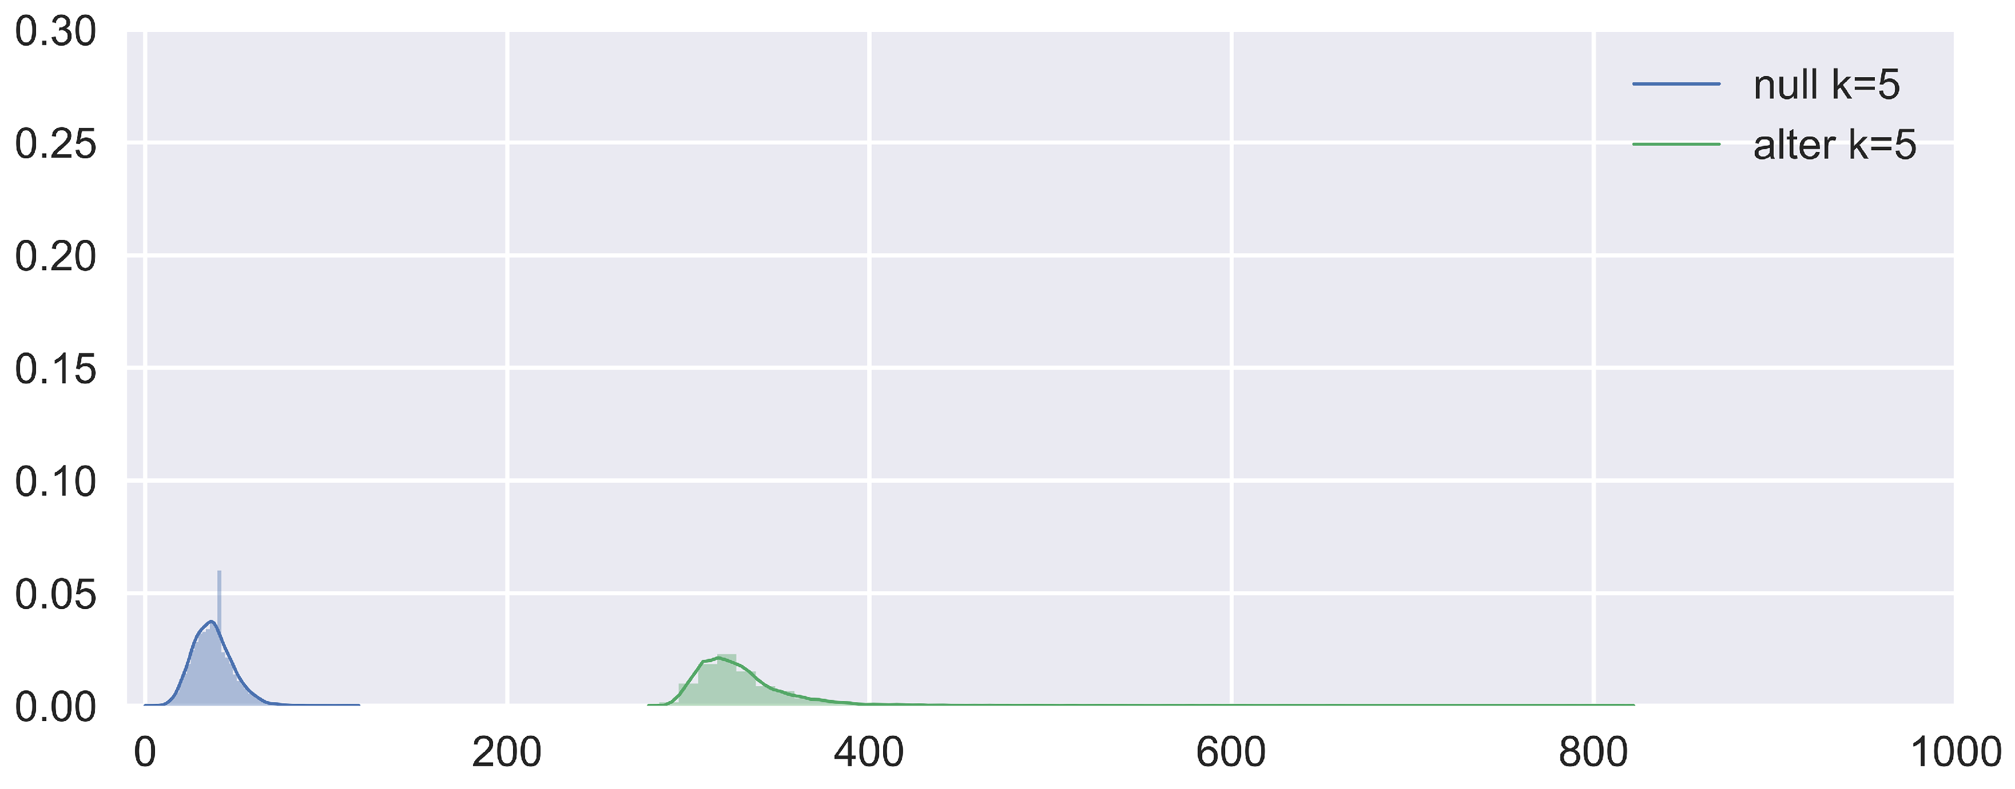
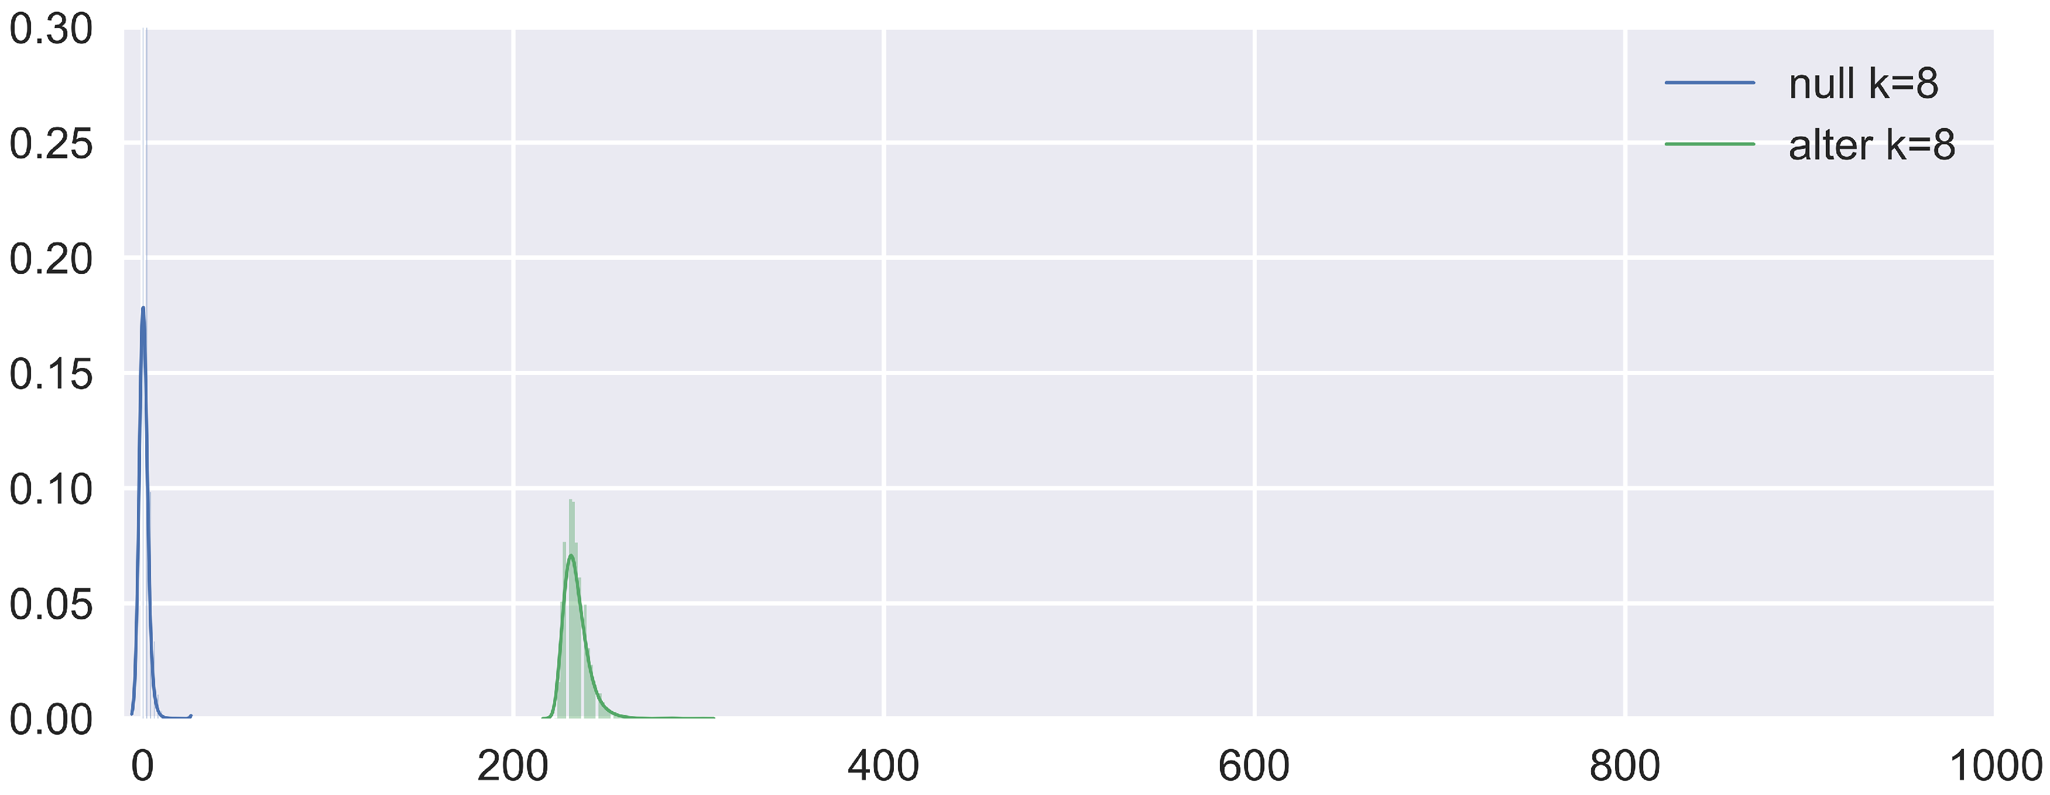
$D_{2}^{R}$ properties
Discriminate Repeats from Non-repeats
Between
Group
Comparison

Slide 10
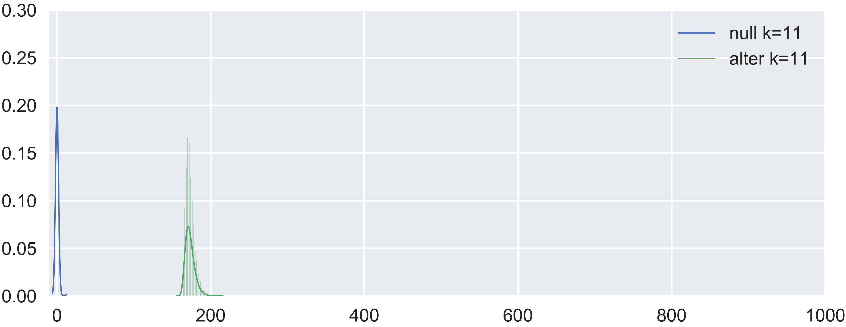
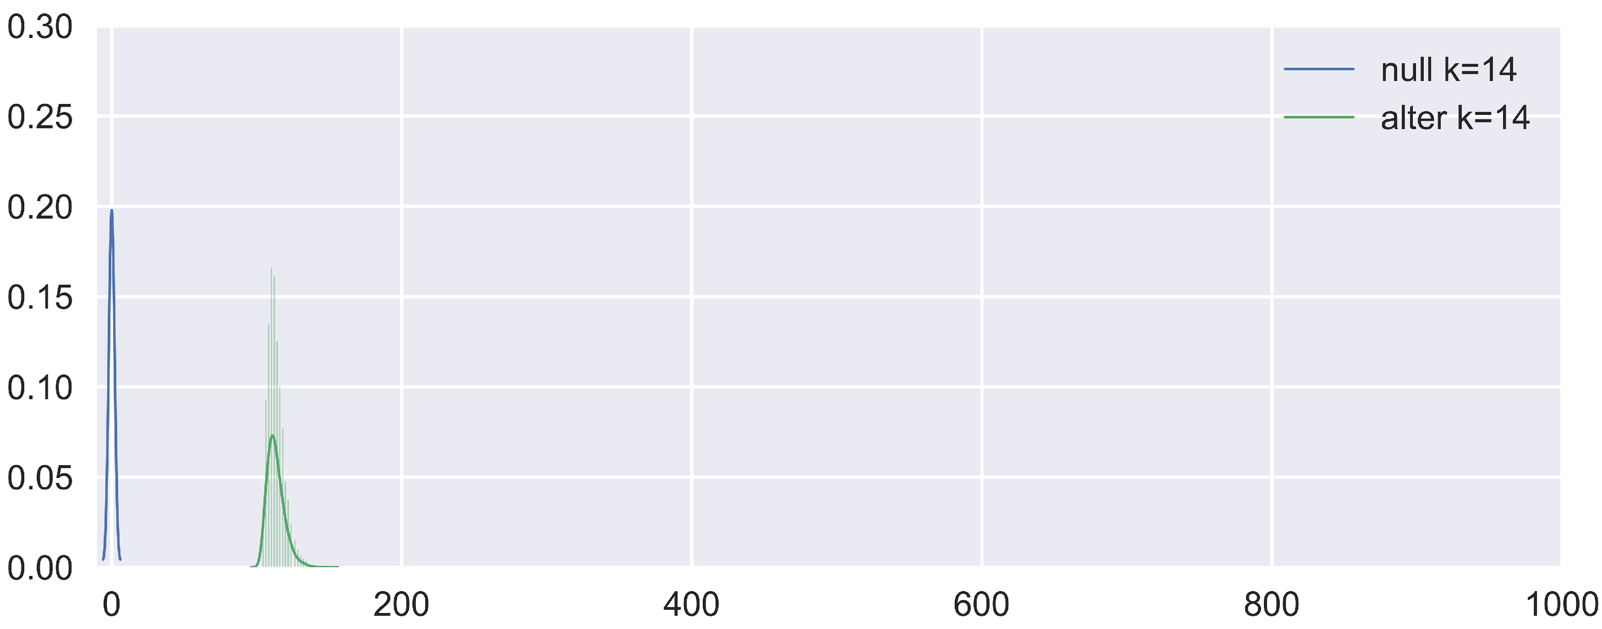
$D_{2}^{R}$ properties
Discriminate Repeats from Non-repeats
Between
Group
Comparison

Slide 11
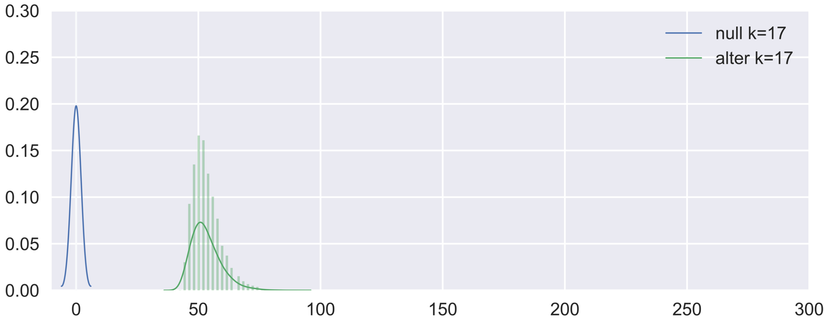
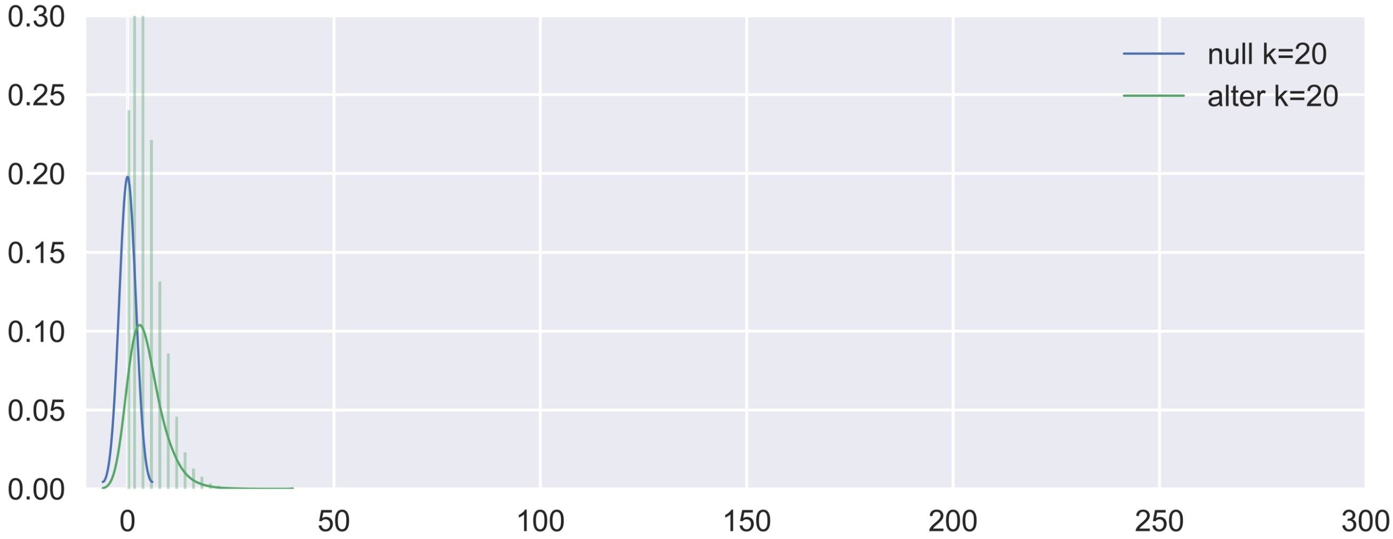
$D_{2}^{R}$ properties
Discriminate Repeats from Non-repeats
Between
Group
Comparison
Too large k
fails to discriminate
repeats from
non-repeats !

Slide 12
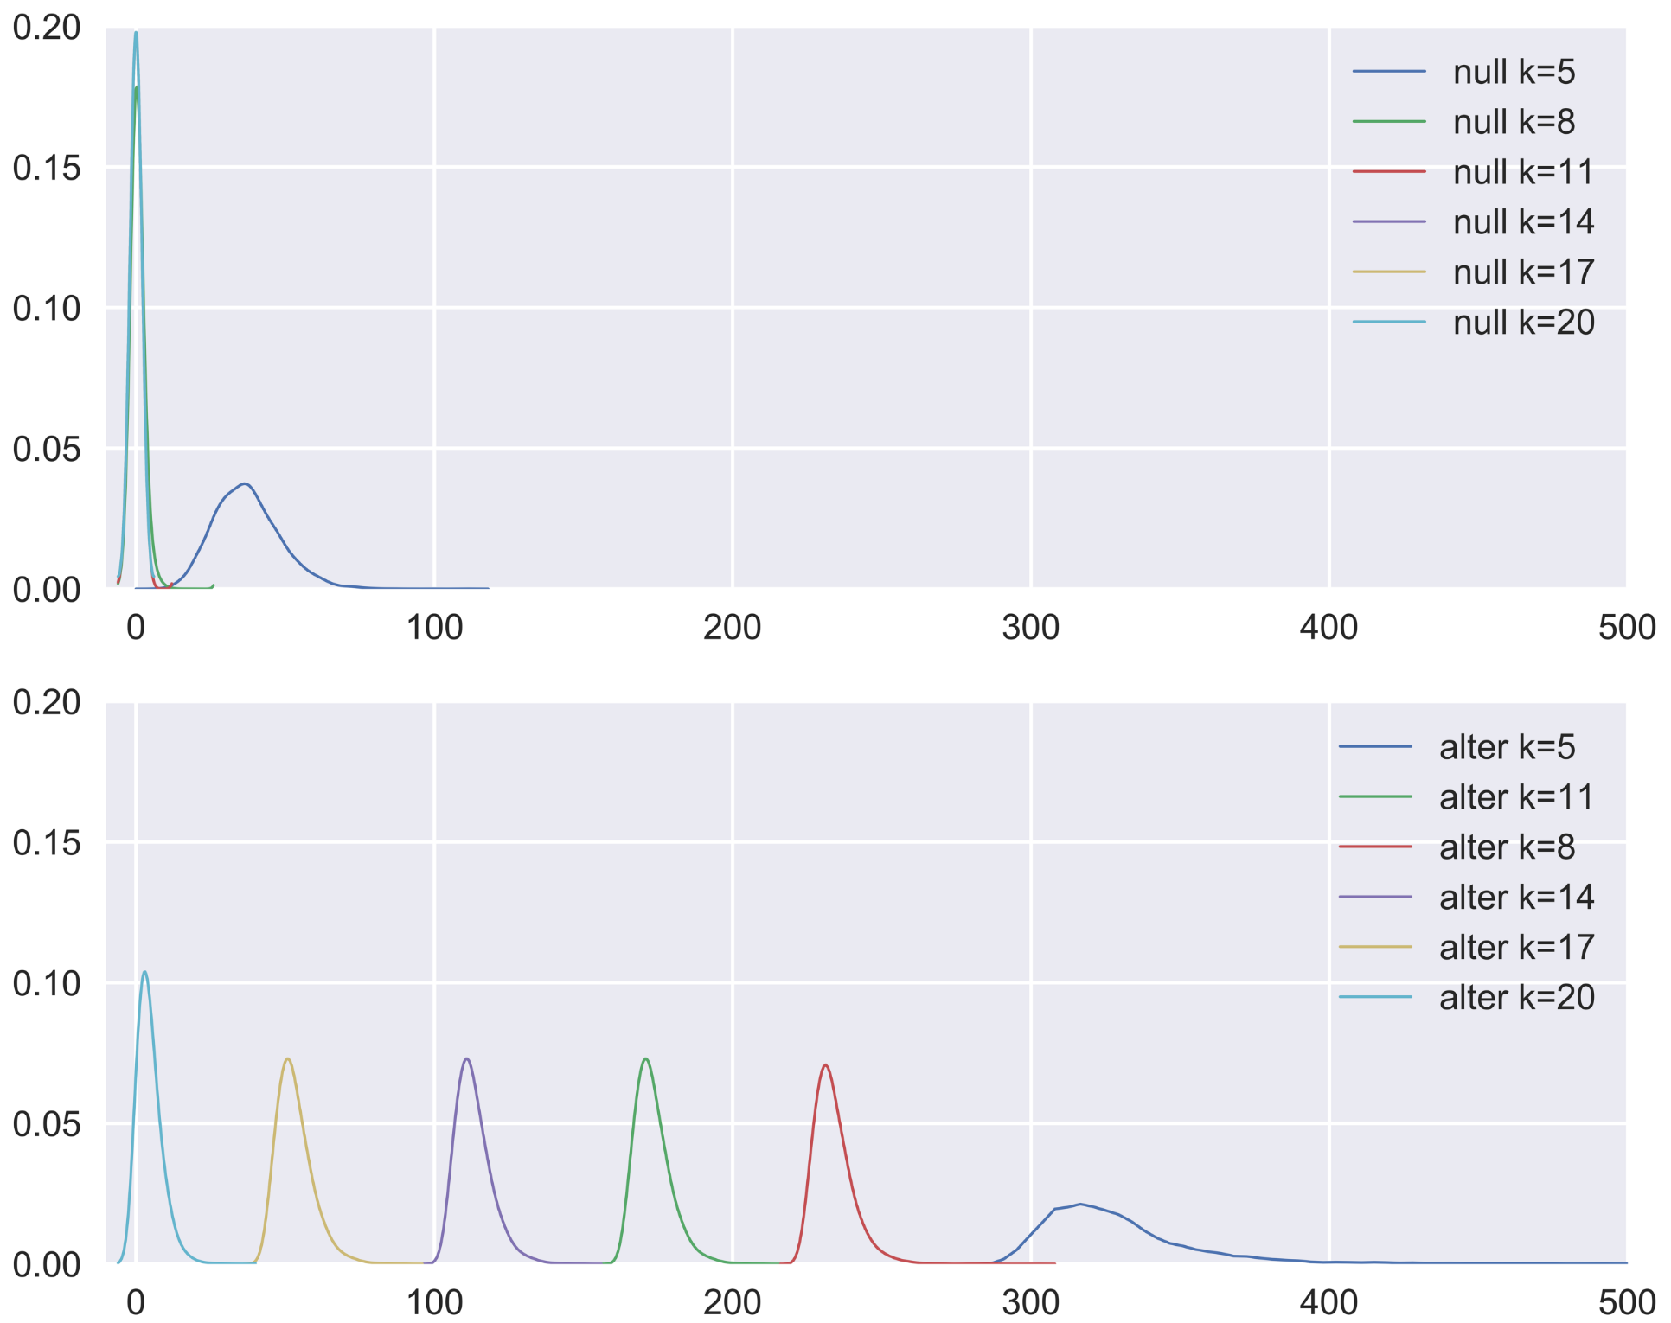
$D_{2}^{R}$ properties
Discriminate Repeats from Non-repeats
Within
Group
Comparison

Slide 13
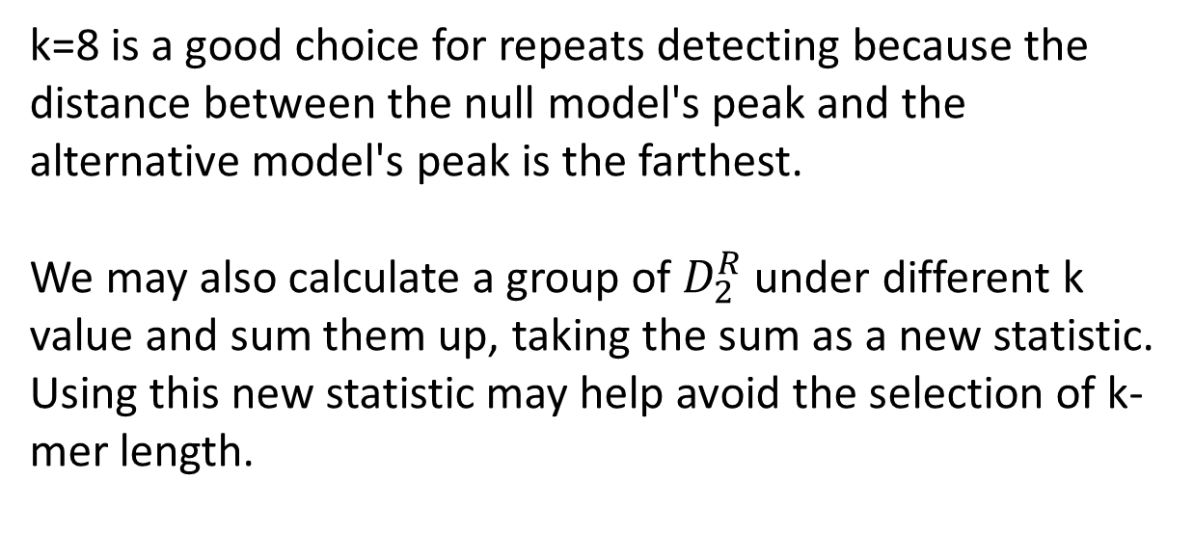
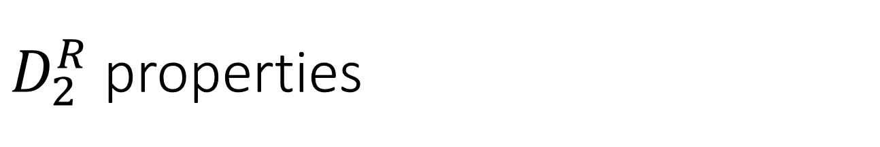
$D_{2}^{R}$ properties
k=8 is a good choice for repeats detecting because the distance between the null model's peak and the alternative model's peak is the farthest.
We may also calculate a group of $D_{2}^{R}$ under different k value and sum them up, taking the sum as a new statistic. Using this new statistic may help avoid the selection of k-mer length.

